Slide 1
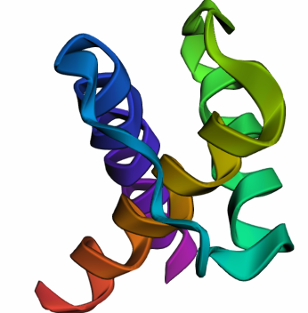
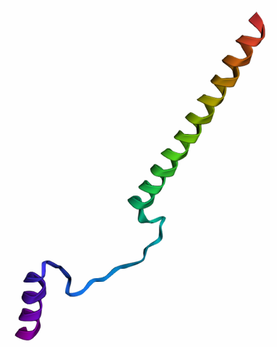
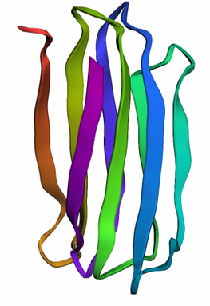


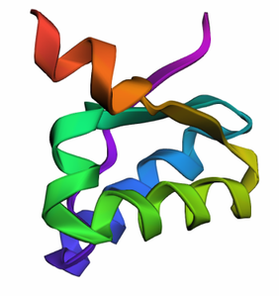
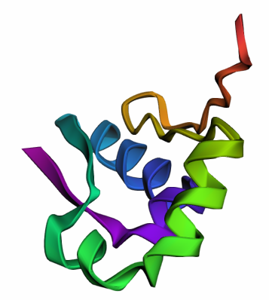
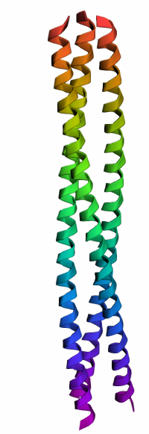
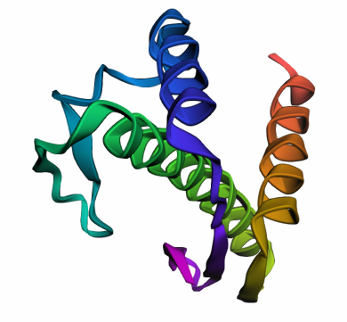
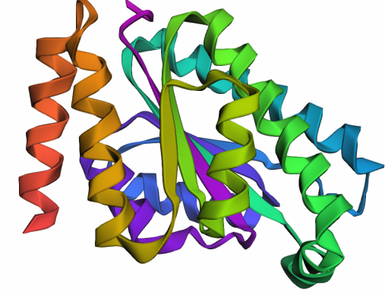
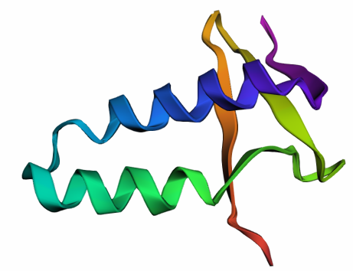
Multi-Agent AI Systems for De Novo Protein Design
Protogenix: An Automated Protein Design Multi-Agent Framework
Name: Konouz Abdelaziz Elsayed
ID: 227447
Supervisor: Prof. Andreas Pester
Major: Artificial Intelligence
1

Slide 2



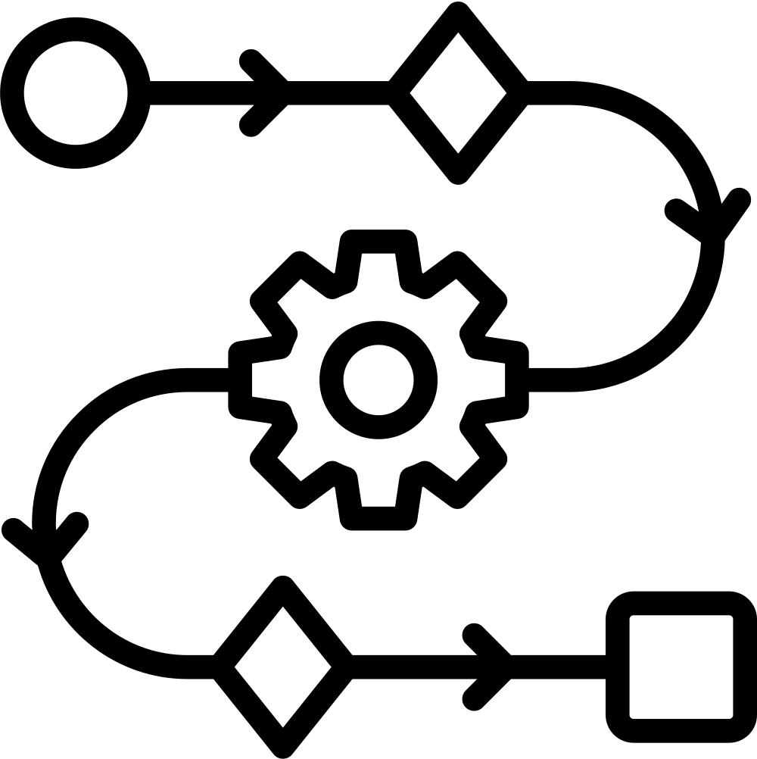

Problem Background
What are De Novo proteins and Why are they important?
Why Use a Multi-Agent System?
Proteins are the building blocks of life - enzymes, drugs, antibodies
Applications in medicine, matrial science, enviromental engineering
20^200 possible sequences = computational nightmare
Protein design is inherently multi-step
Easier debugging, iterative improvement, and reduced human oversight
More transparent, flexible, and maintainable than monolithic LLMs
Current methods: slow (weeks-months), expensive ($ 1 K-$10 K), high failure rates
The Gap: No integrated system combining AI agents with real-world protein design tools
2

Slide 3
Research Questions
Can multi-agent systems automate de novo protein design?
From user request → final validated protein structure
Can this system outperform traditional or SOTA methods in speed, cost, or quality?
Baker’s Lab and ProtAgents framework
How well does the system adapt to failure and perform iterative improvement?
Iterative refinement and memory-guided optimization
3

Slide 4



Methodology
Core Technologies & Implementation
Ollama + Mistral:instruct: Local LLM deployment for cost-effective inference
Extensive prompt engineering: Role-based instructions + one-shot examples
LangGraph: A Cyclic, State-based agent coordination framework with dynamic branching
Advanced Tool Integration
Protein Tools: Chroma, OmegaFold, ANM, PubMed RAG
Model Context Protocol (MCP); UniProt Search
Evaluation:
Quantitative Metrics: pLDDT scores, RMSD values, sequence composition
Qualitative Assessment: Multimodal visual analysis using Gemini-2.0-flash
Monitoring via Langsmith
4

Slide 5
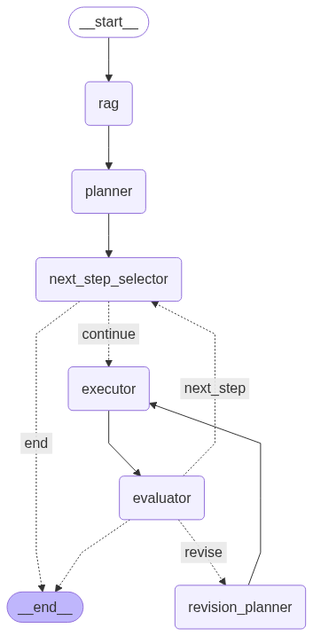

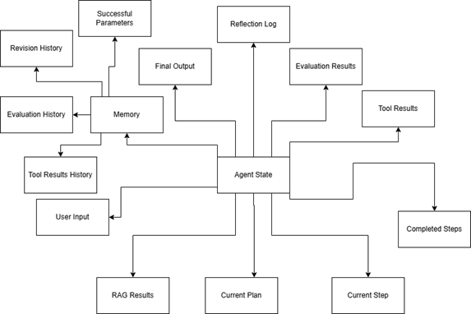


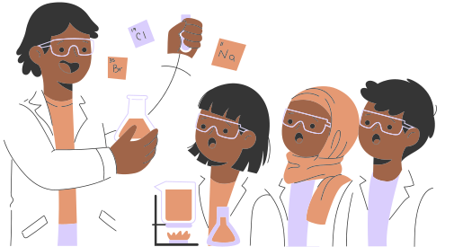


System Architecture
Input
Digital Protein Lab
Nodes = agents
Shared memory = Agent State
5
Output

Slide 6
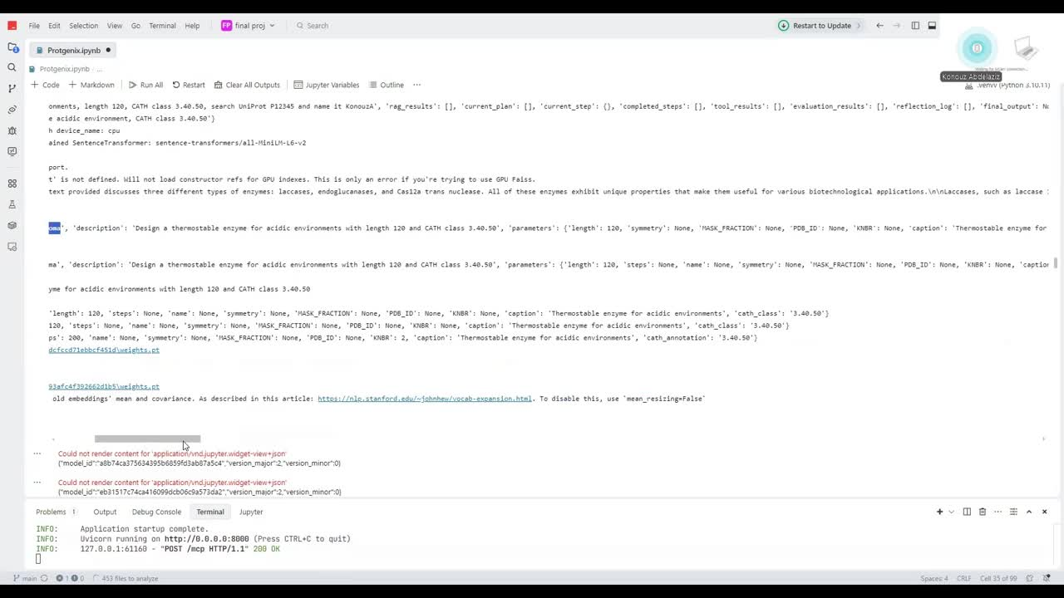
Sample 1
6

Slide 7
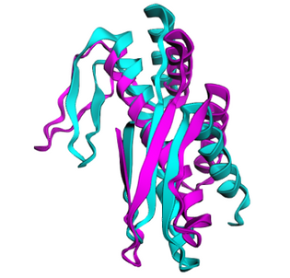
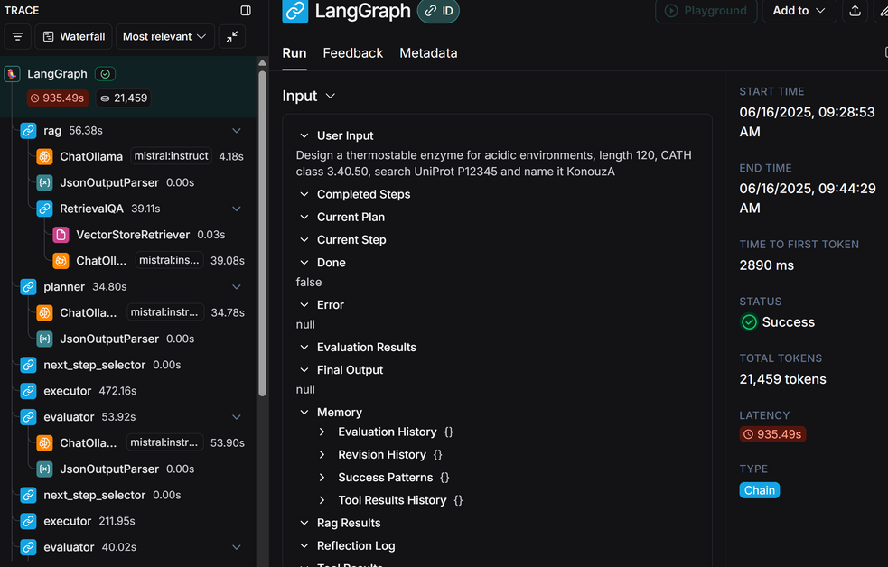
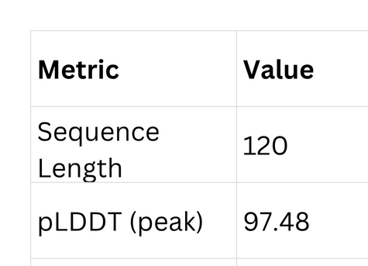
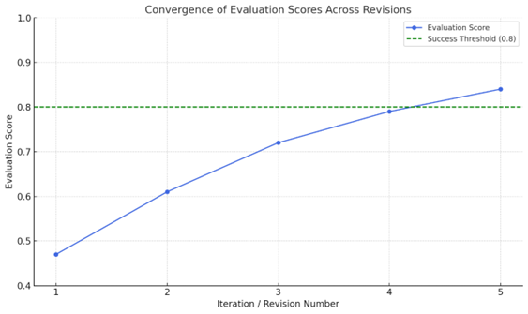
Sample 1
“Design a thermostable enzyme for acidic environments, length 120, CATH class 3.40.50, search UniProt P12345"
7

Slide 8
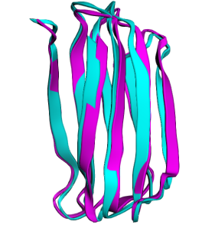
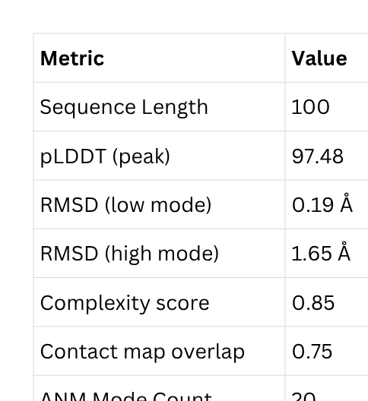
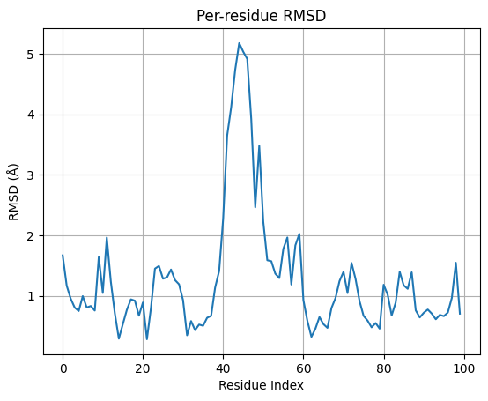
Sample 2
“Design a highly stable protein with a beta-barrel structure’
8

Slide 9
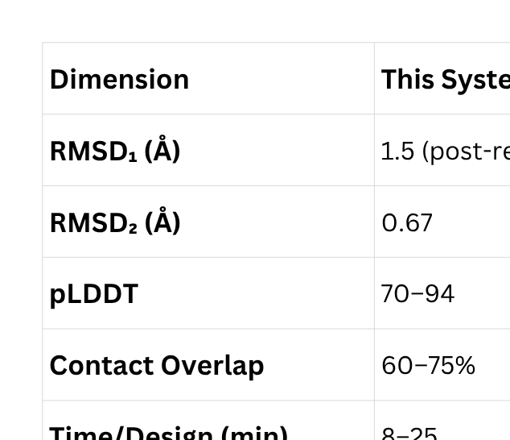
Comparison to SOTA and real-life pipelines
9

Slide 10
Trials and Challenges
Challenge 1: LLM Consistency
Problem: JSON formatting errors, parameter mismatches
Solution: Extensive prompt engineering + one-shot examples
Challenge 2: Tool Integration
Problem: Different APIs, formats, dependencies
Solution: Unified MCP (Model Context Protocol) architecture
Challenge 3: Memory Management
Problem: LangGraph cycles, state persistence
Solution: Centralized agent state + checkpoint system
10

Slide 11
Contributions
New architecture: human-lab-like automated multi-agent model
Better resource efficiency and cost-effectiveness
95% success rate after automated revision (vs. 80% ProtAgents)
8-25 minutes per design vs. months for traditional methods
11

Slide 12
Future Work
Larger language models (still open source) for better reasoning
Graph RAG for enhanced context management
AlphaFold3 integration for improved structure prediction
Experimental validation partnerships
Cloud deployment for scalability
12

Slide 13

Thank You
Any Questions?
13

